Slide 1
Ohm’s Law
Ω

Slide 2
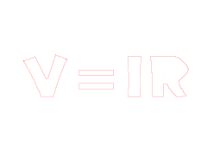
INTRODUCTION
TO
OHM’S LAW

Slide 3
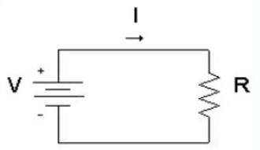
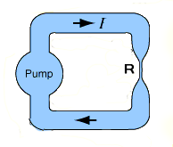
Ohm's Law:
Ohm's law defines a linear relationship between the voltage and the current in an electrical circuit. The resistor's voltage drop and resistance set the DC current flow through the resistor. With water flow analogy we can imagine the electric current as water current through pipe, the resistor as a thin pipe that limits the water flow, the voltage as height difference of the water that enables the water flow.

Slide 4
Definitions:
Ohm’s Law: Current through an ideal conductor is proportional to the applied voltage.
Voltage = Current x Resistance
V = I x R
Current: Current is the rate of charge flow through a circuit. It is measured in Amperes(A).
Voltage: Voltage is the electrical force or pressure that causes the current to flow in a circuit. The unit of voltage is Volt(V)
Resistance: Resistance measures how difficult it is for current to flow. The unit of resistance is Ohm(Ω).

Slide 5



Current calculation:
When we know the current and resistance, we can calculate the voltage.
The Current(I) is equal to the to the Voltage(V) divided by the Resistance(R).
$I=\frac{V}{R}$
Voltage calculation:
When we know the current and the resistance we can calculate the voltage.
The Voltage(V) is equal to the Current(I) times the Resistance(R).
$$V= I R$$
Resistance calculation:
When we know the voltage and the current, we can calculate the resistance.
The Resistance(R) is equal to the Voltage(V) divided by the Current(I) .
$R=\frac{V}{I}$

Slide 6

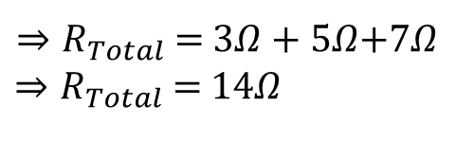


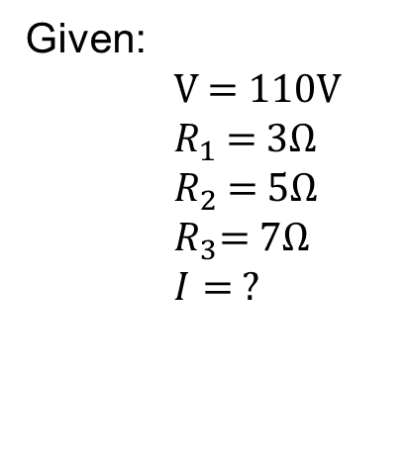




Simple circuit’s solution: (Using only Ohm’s law)
A 110v supplies a load with a resistance of 3Ω, 5Ω, and 7Ω respectively, what is the current in the circuit?
I
$R_{1}$ = 3Ω
V = 110V
$R_{2}$ = 5Ω
$$R_{3}\text{= }\text{7}\text{Ω}$$
Given:
V = 110V
$R_{1}$ = 3Ω
$R_{2}$ = 5Ω
$R_{3}\text{= 7}\text{Ω}$
$I= ?$
$R_{Total}$ =${ R}_{1}+{ R}_{2}$+${ R}_{3}$
$$V=IR$$
$⇒R_{Total}$ =$3Ω+5Ω$+7$Ω$
$⇒R_{Total}$ =$14Ω$
$⇒I$ = $\frac{V}{R}$ = $\frac{110}{14}$ =7.9A
$ANS:$7.9A

Slide 7

HISTORY

Slide 8
We considered Ohm's law history into two steps:
1st step:
Henry Cavendish: Experimented with Leyden jars and glass tubes. He said "Velocity valid directly as the degree of electrification"
In 1814, Frances Ronalds delineated voltage and current in different condition for dry pile.

Slide 9
2nd step:
Georg Ohm Stared work from 1825 to 1826. Published his results in 1827 as the book " The galvanic circuit investigated mathematically"
Where
x = Reading for galvanometers.
I = Length of the text conductor.
B = Constant entire setup.
Ohm' s work long proceeded Maxwell's equation and understanding of the frequency dependent effects in AC circuits.

Slide 10

MICROSCOPIC
EXPLANIATION

Slide 11
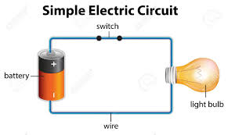
Current flow (I): An electric circuit is formed when a conductive path is created to allow free electrons to continuously move.
this continuous movement of free electrons through circuit is called current flowed

Slide 12
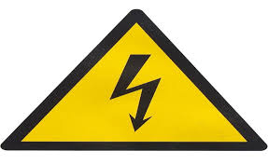
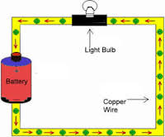
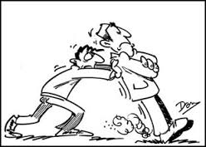
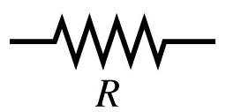
Voltage (V):
The force, motivating electrons to flow in a circuit is called voltage. It always relative between two points. Without reference to two points , the term voltage has no meaning.
Resistance (R):
Free electrons tends to move through conductors
with some degree of friction .This friction or opposition to motion is called resistance.

Slide 13
Current flow is directly proportional to its motivational force. More the free electrons excited, more the current flow exists in the circuit. And this excitement is created by the motivational force, generally called voltage. i.e.
V ∝ I
To make this term as equation , a constant is needed. Here, resistance is the required constant.
V=IR

Slide 14
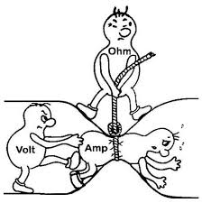
Resistance tries to resist the current flow in the circuit. So, it must be a opposite term to the current flow I. And From the mathematical term, it is clear that, when the voltage is constant, the resistance is inversely proportional to the current flow
I ∝ 1/R
That means, more the resistance exists, less the current will flow in the circuit.

Slide 15

CIRCUIT
ANALYSIS

Slide 16
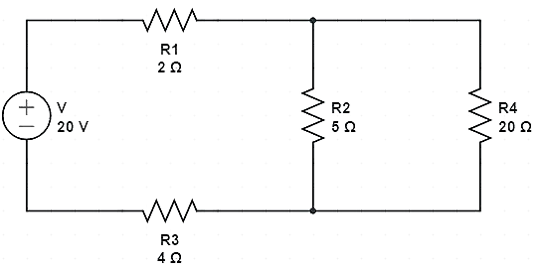











$${ V}_{1}$$
I
$$I_{1}$$
$${ V}_{2}$$
$${ V}_{4}$$
$$I_{2}$$
$$I_{4}$$
$${ V}_{3}$$
$$I_{3}$$
1. Equivalent Resistance of the circuit.
1. $V=IR$
2. Total current of the circuit.
3. Individual current through each resistance.
2. $R_{s} =$ $R_{1}+R_{2}+R_{3}$…
4. Individual voltage across each resistance.
3. $R_{p} =$ ${(\frac{1}{R_{1}}+\frac{1}{R_{2}}+\frac{1}{R_{3} }…)}^{−1}$

Slide 17
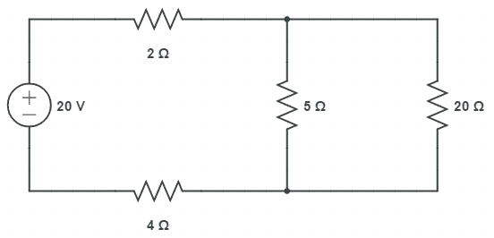
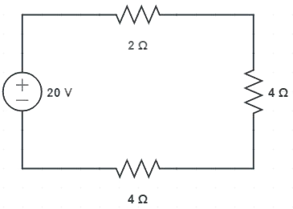
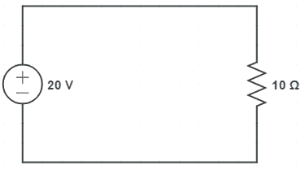











I
$$I_{4}$$
$$I_{2}$$
$R_{p} =$ ${(\frac{1}{5}+\frac{1}{20} )}^{−1}$
${⇒R}_{p} =$ 4Ω
I
$R_{s} =$ ($2+4+4)$
$$⇒R_{s}=10\text{Ω}$$
$R_{s}$ = R = $10\text{Ω}$
I
$V=IR$
$⇒ I=$ $\frac{V}{R}$
$⇒ I=$ $\frac{20}{10}\text{A}$
$⇒ I=$ 2$\text{A}$

Slide 18















I
$\text{I} =$ 2$\text{A}$
I
$V=IR$
$V_{1}=2\text{×}$2 V = 4V
$I_{1}$ = $\frac{4}{2}$ = 2$A$
$V_{3}=\text{2}\text{×}$4 V = 8V
$I_{3}$ = $\frac{8}{4}$ = 2A
$V_{t}=\text{2}\text{×}$4 V = 8V
$I_{t}$ = $\frac{8}{4}$ = 2A
$$V_{t}$$
I
$I_{2}$ = $\frac{V_{t}}{R_{2}}=\frac{8}{5}$ = 1.6 A
$$I_{2}$$
$$I_{4}$$
$I_{4}$= $\frac{V_{t}}{R_{4}}$ = $\frac{8}{20}=0.4$ A
$V_{2}=I_{2}R_{2}$ = $\text{1}\text{.6}\text{×}\text{5}$ = 8V
$V_{4}=I_{4}R_{4} \text{= 0.4}\text{×}\text{20}$ = 8V

Slide 19








${ V}_{1}$= 4V
$I_{1}$ = 2A
I = 2A
$${ V}_{2}=8V$$
$${ V}_{4} =8V$$
$$I_{2}=1.6A$$
$I_{4}$ = 0.4A
${ V}_{3}$ = 8V
$I_{3}$ = 2A

Slide 20

TEMPERATURE EFFECTS

Slide 21
Temperature Effects
Ohm's law has sometimes been stated as, "for a conductor in a given state, the electromotive force is proportional to the current produced." That is, that the resistance, the ratio of the applied electromotive force(or voltage) to the current, "does not vary with the current strength.

Slide 22

Resistance: Temperature Coefficient
Since the electrical resistance of a conductor such as a copper wire is dependent upon collisional processes within the wire, the resistance could be expected to increase with temperature since there will be more collisions.
An intuitive approach to temperature dependence leads one to expect a fractional change in resistance which is proportional to the temperature change:

Slide 23

Or, expressed in terms of the resistance at some standard temperature from a reference table:

Slide 24
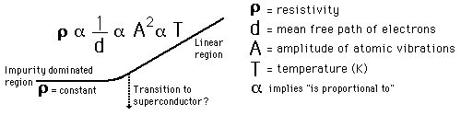
Low Temperature Resistivity
Microscopic examination of the conductivity shows it to be proportional to the mean free path between collisions (d), and for temperatures above about 15 K, d is limited by thermal vibrations of the atoms. The general dependence is summarized in the proportionalities.

Slide 25
Low Temperature Resistivity

